Slide 1

Project Name: Samsung mobile phone Stores Management System

Slide 2
Members:
HAQ IJAZ UL (ID:2820150066)
Jalil Furqan (ID:2820150079)
Ron wong See (ID:2820150151)

Slide 3

Site Communication Model
Branch1
Branch2
Internet
DB2
（MySql）
DB1（MySql）
Head Office

Slide 4
User needs
1. Samsung chain is composed of a head office ( virtual characters ) , samsung imposed of two branches , and different areas where each branch
2. supermarket chains carried out between headquarters and branch transmission of data, but not for data transmission between the branches, data exchange using a local area network.
3. Total manager this role can be summarized a store selling information ( distributed) , summary stores employee information ( distributed) , there is information ( copy) of each branch
4. Long Branch , the staff just do their own local centralized database management ( add, delete, change, check ) , it does not involve the distributed management . Which stores employee information and local staff and local sales information , local vendor information , purchase local information, local product information, management information and stores the local sale of information

Slide 5
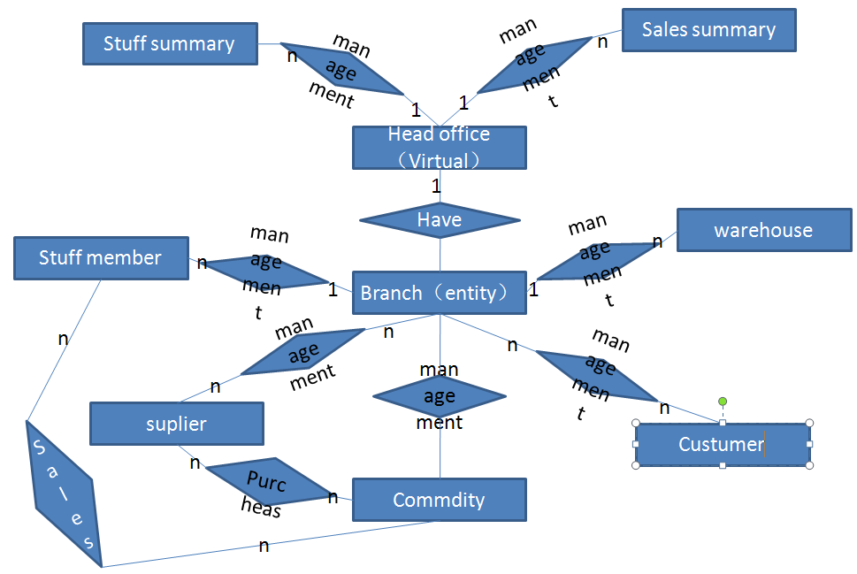
Overall database ER diagram

Slide 6
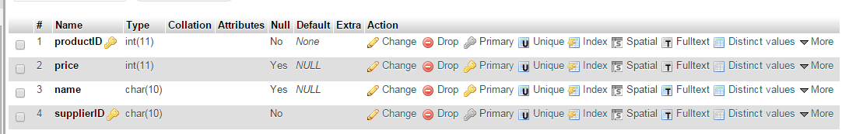
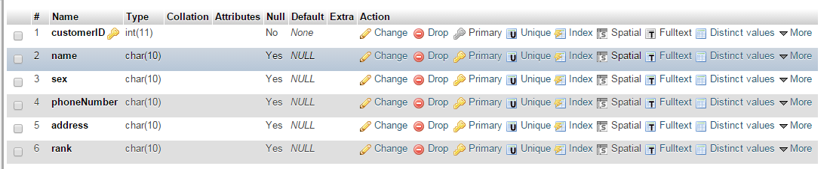
Database screen shots

Slide 7
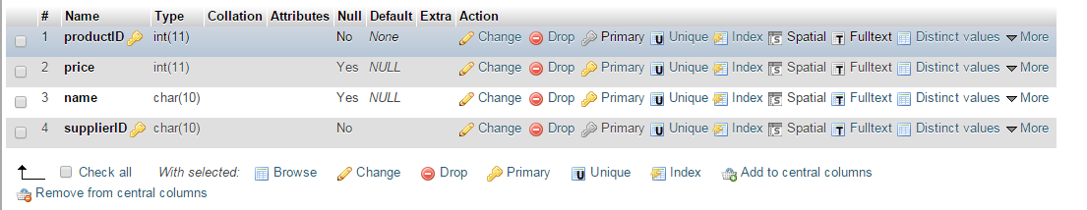
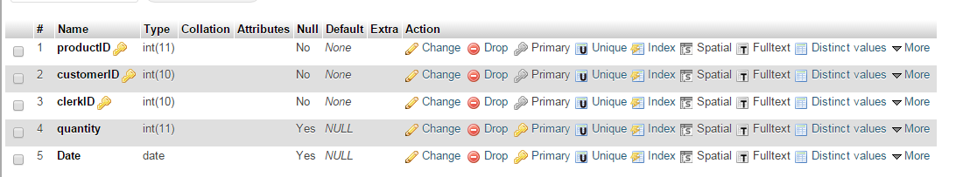
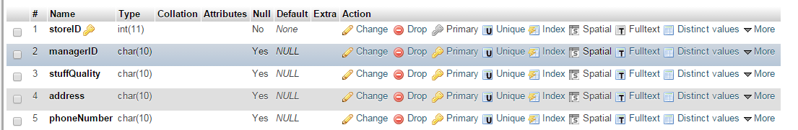

Slide 8
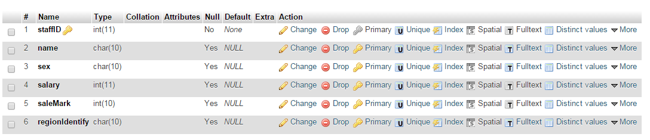
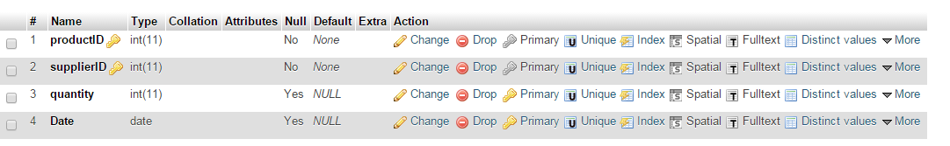
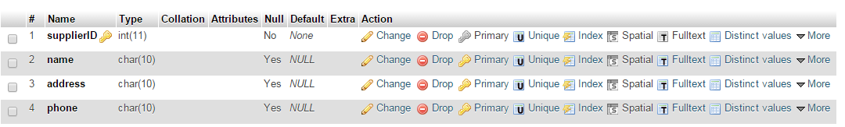

Slide 9
Fragmented and distributed databases
The level of fragmentation : staff, warehouse ( different division Area )
Copy : shop ( both sites have )
Other redundant storage

